Slide 1
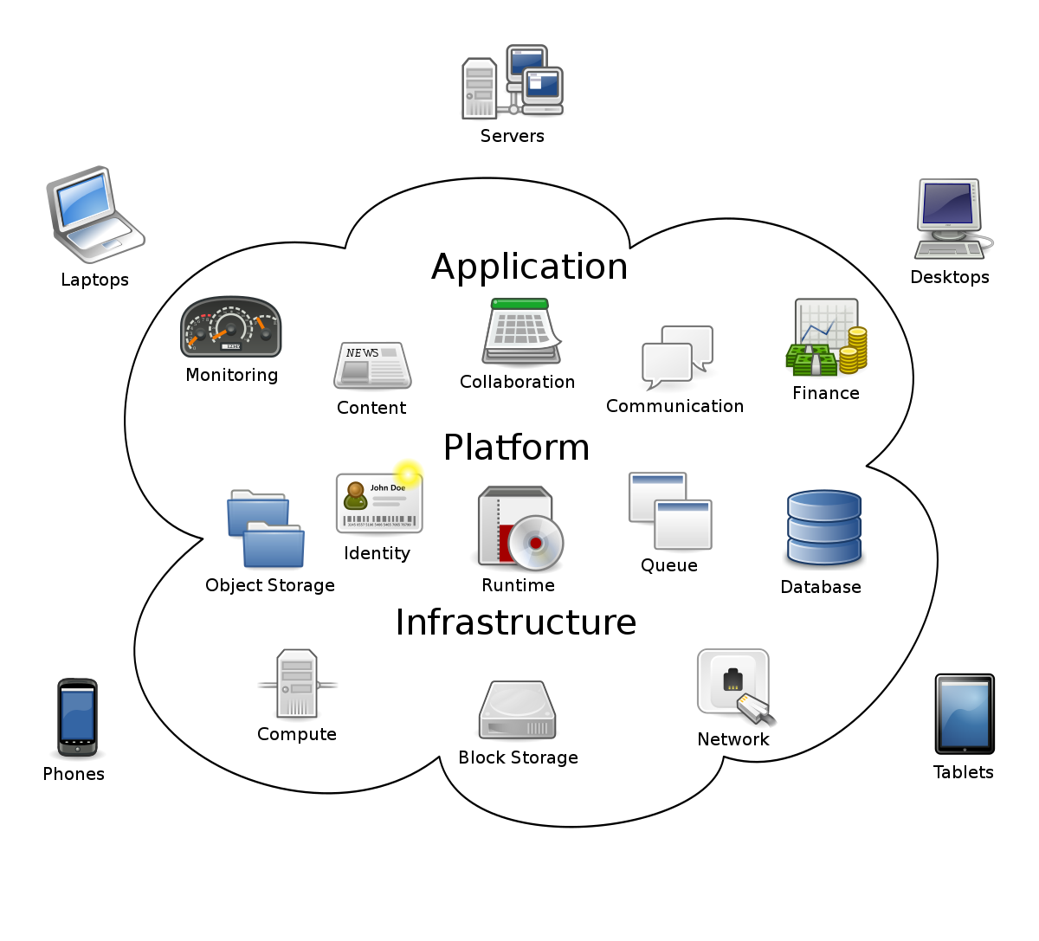

Slide 2
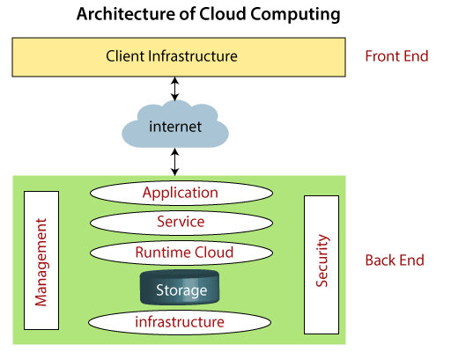

Slide 3
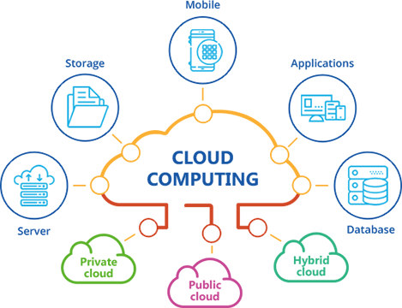

Slide 4
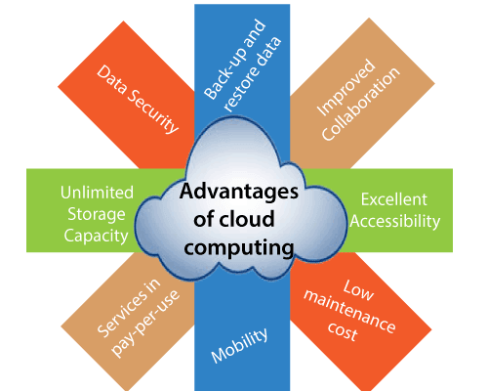

Slide 5
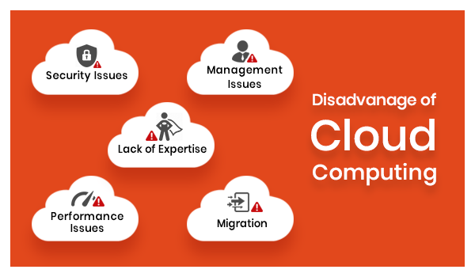

Slide 6
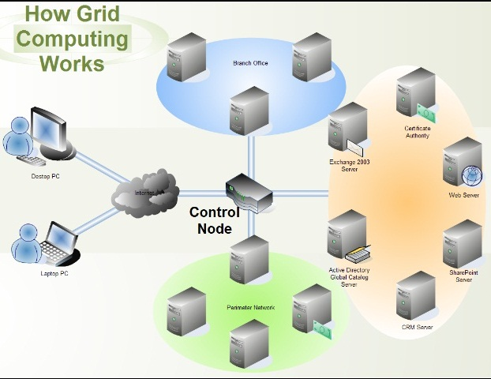

Slide 7
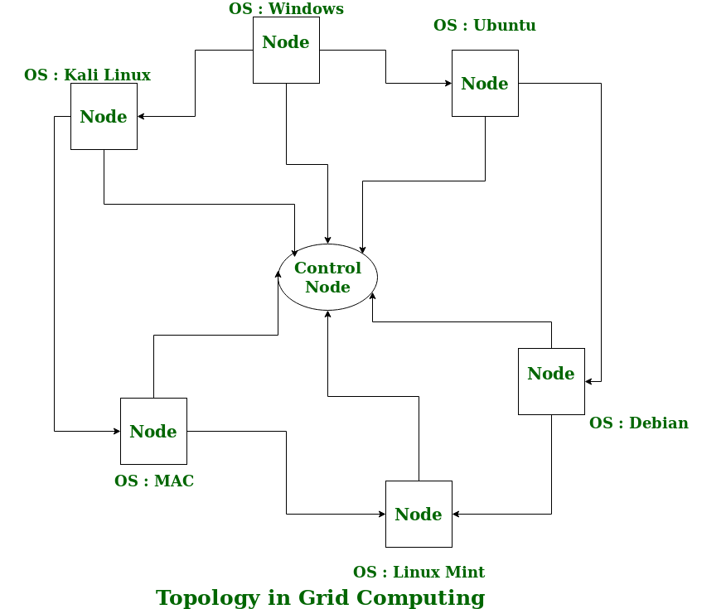

Slide 8
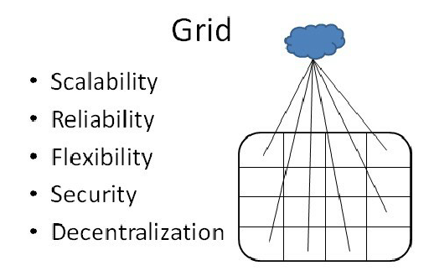

Slide 9
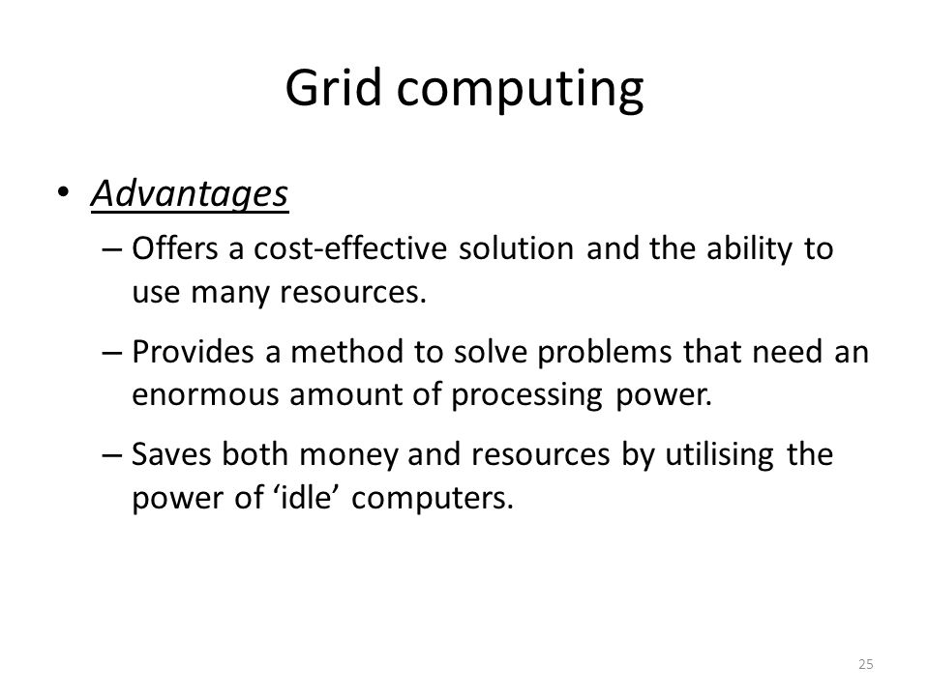

Slide 10
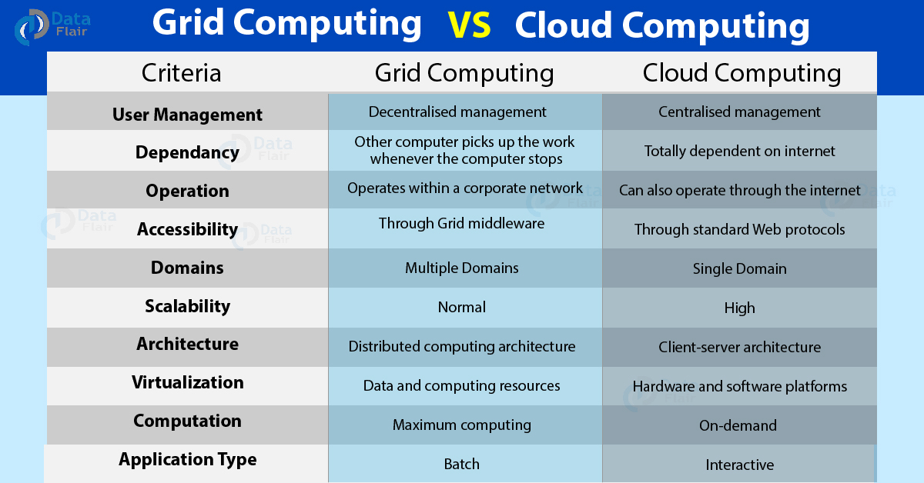

Slide 11
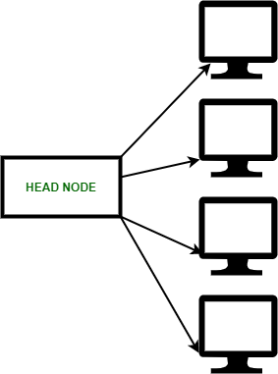
Cluster Computing

Slide 12
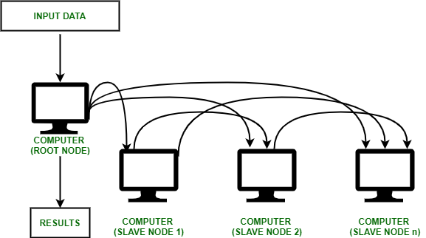

Slide 13
Types of Cluster computing
High performance (HP) clusters
solve advance computational problems,
parallel processing
2. Load-balancing clusters
3. High Availability (HA) Clusters
Classification of Cluster
Open Cluster
Close Cluster

Slide 14
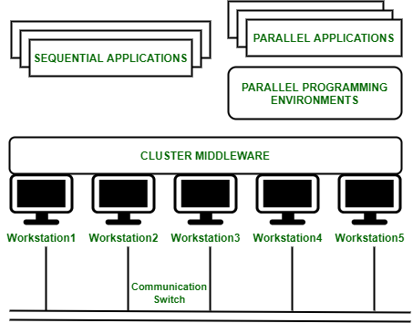
Cluster Computing Architecture
Components of a Cluster Computer :
Cluster Nodes
Cluster Operating System
The switch or node interconnect
Network switching hardware

Slide 15
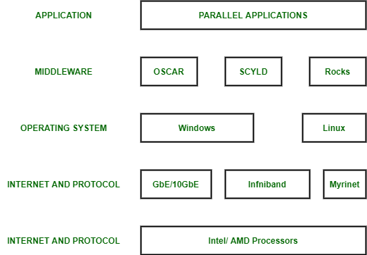
Cluster Components

Slide 16
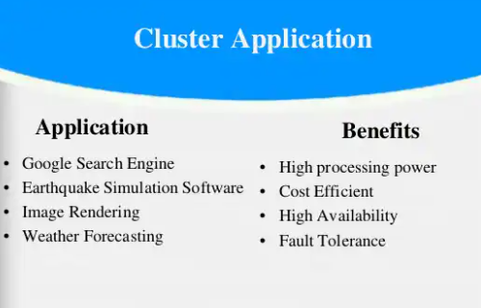

Slide 17
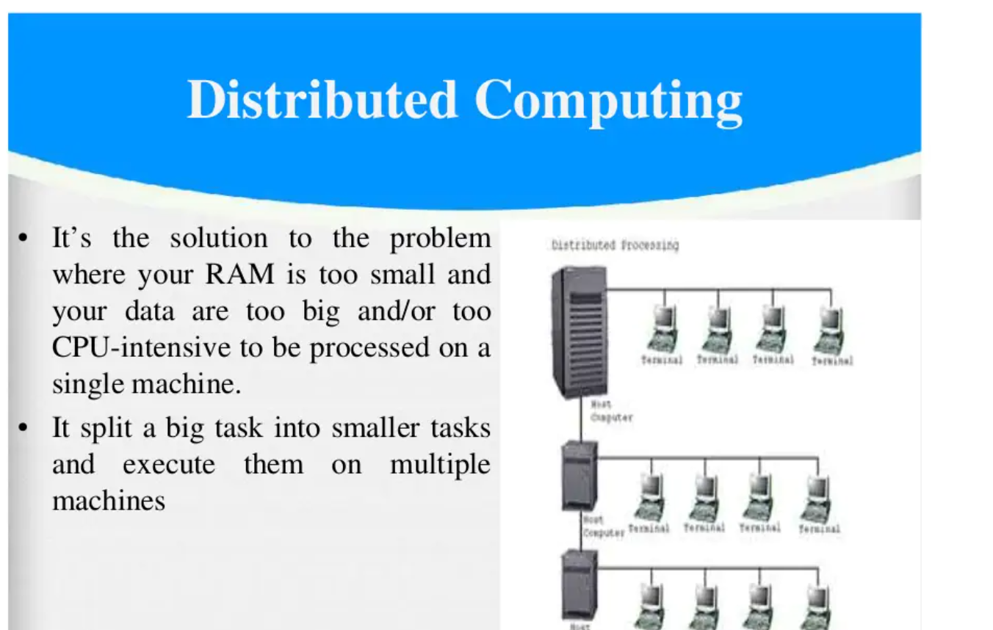

Slide 18
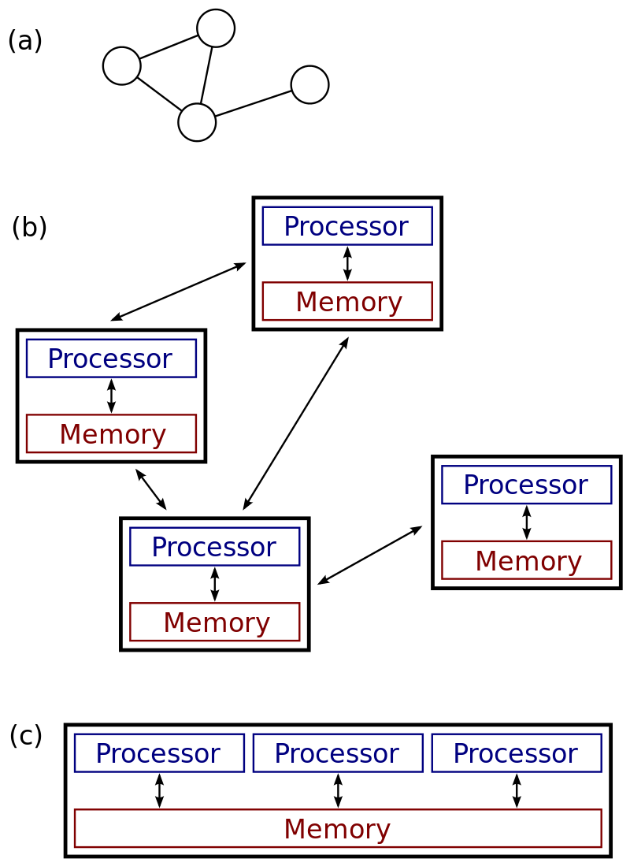
(a), (b): a distributed system. (c): a parallel system.

Slide 19
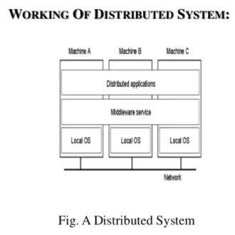

Slide 20
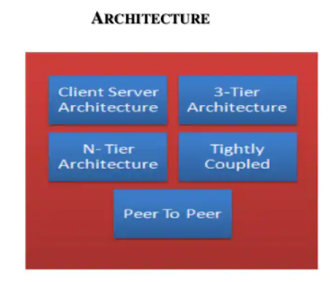

Slide 21
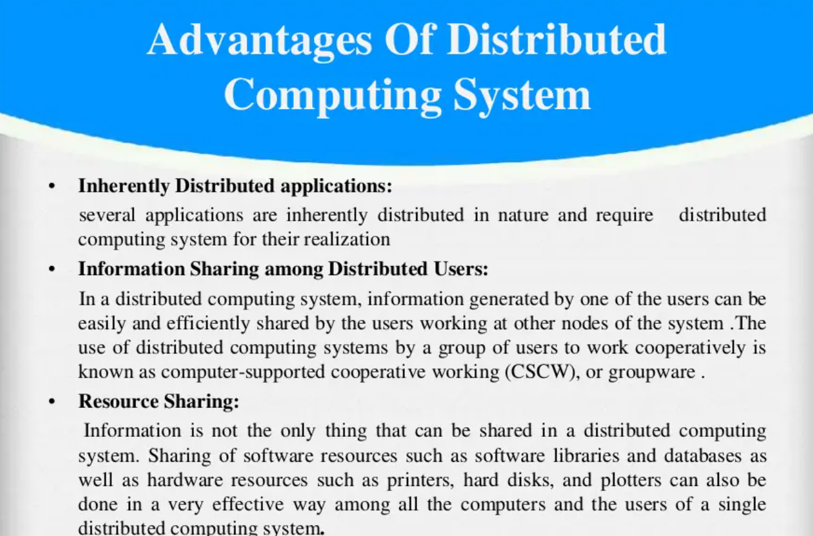

Slide 22
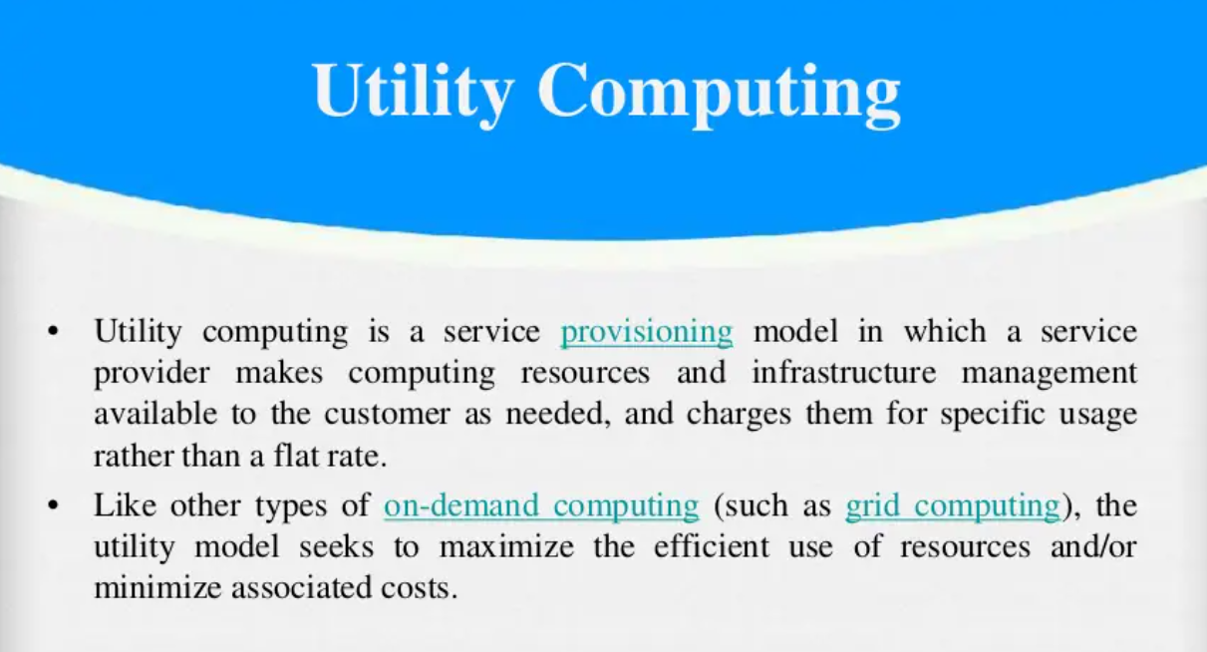

Slide 23
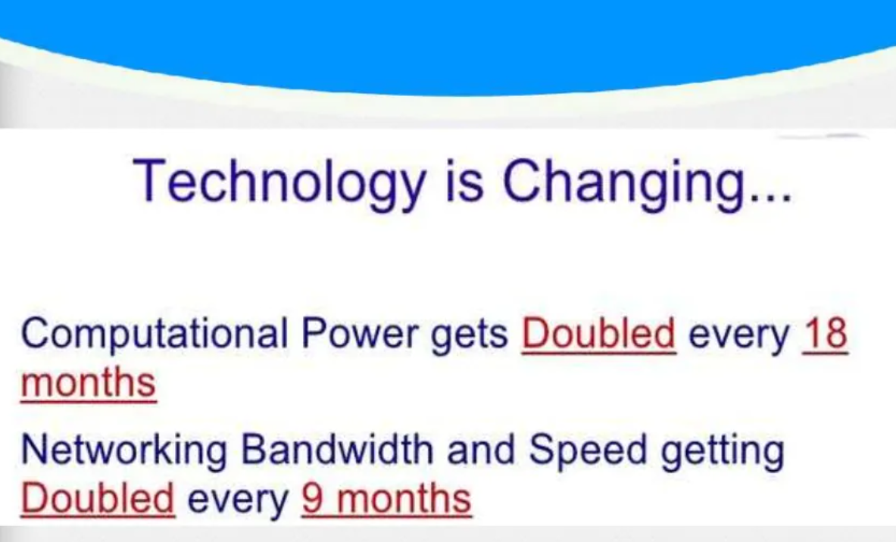

Slide 24
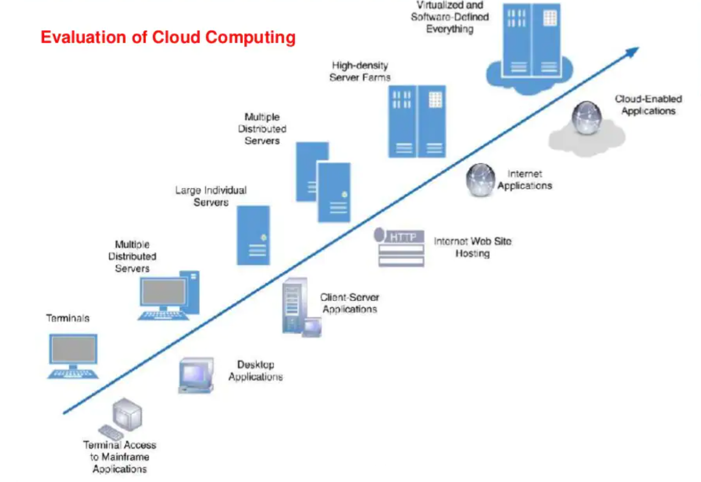

Slide 25
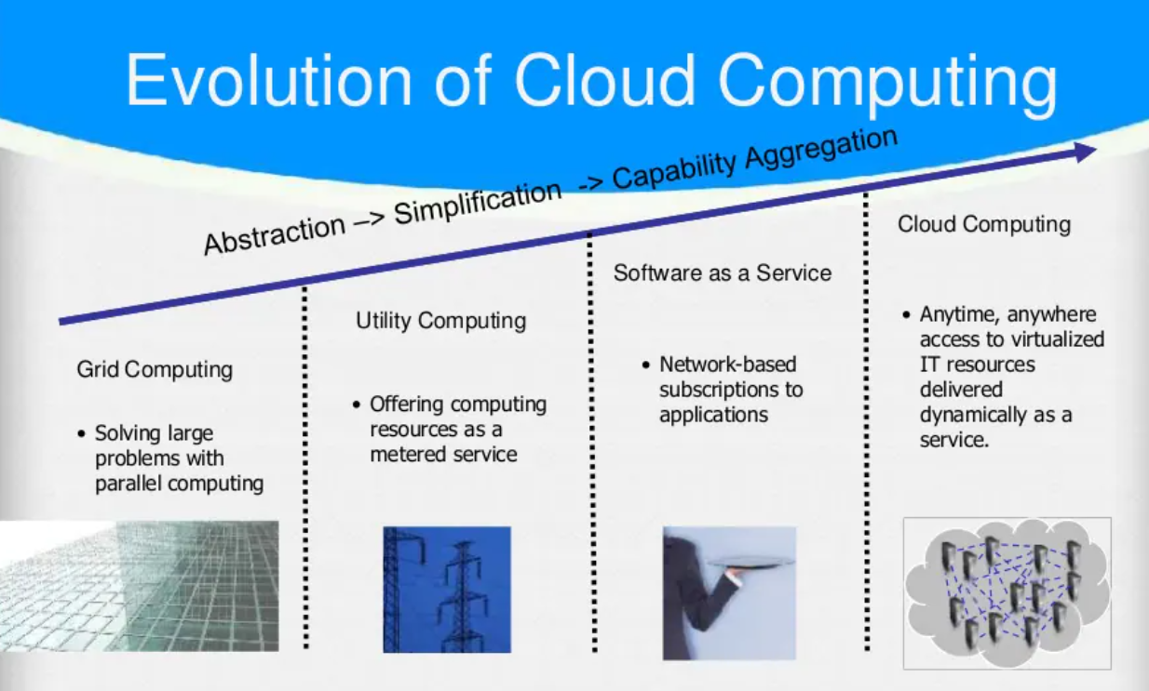

Slide 26
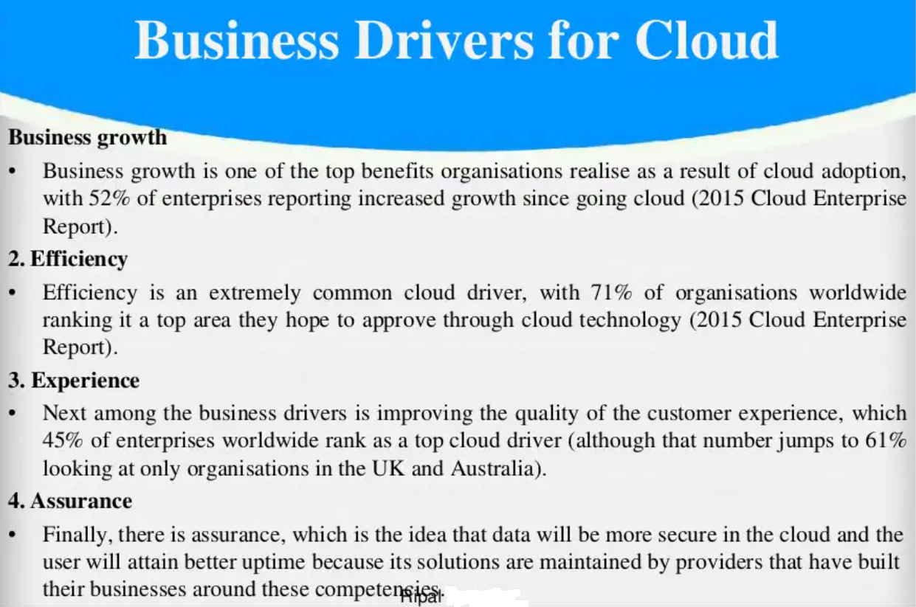

Slide 27
Business Drivers for Cloud
Capacity Planning
Level of Demand
Cost of Production
Availability of Funds
Cost Reduction
Organizational Agility
Role of Open Standards

Slide 28
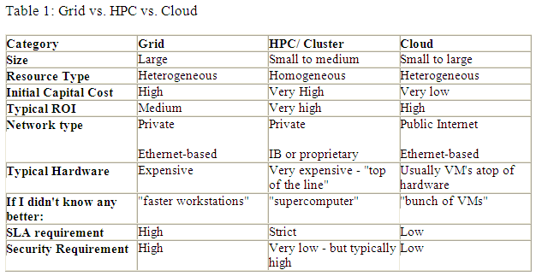

Slide 29
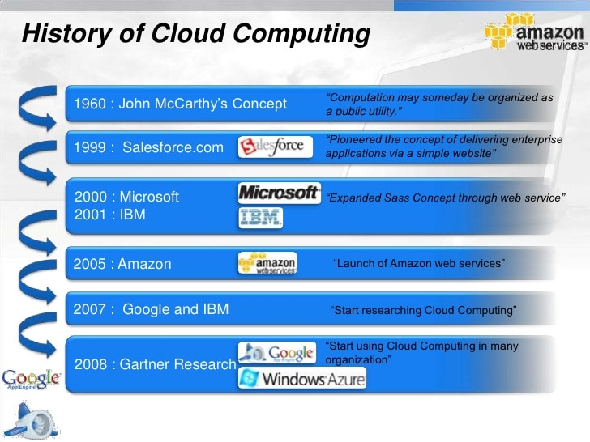

Slide 30
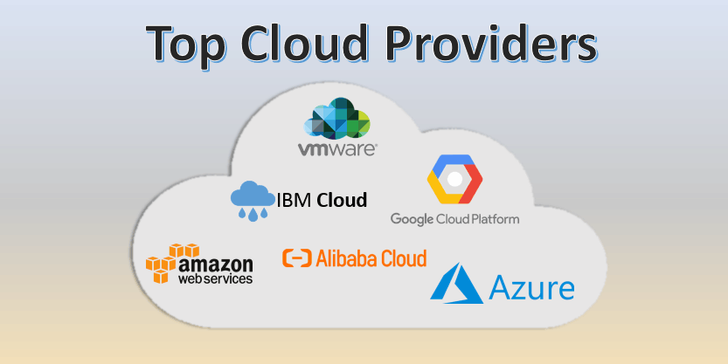

Slide 31
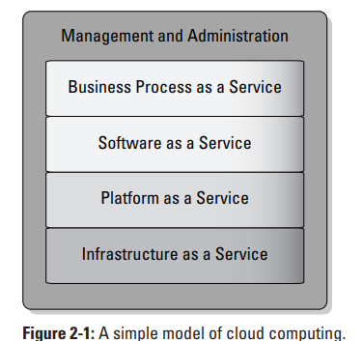

Slide 32
Comparison with traditional computing architecture (client/server)
Cloud Computing | Traditional Computing
It refers to delivery of different services such as data and programs through internet on different servers. | It refers to delivery of different services on local server.
It takes place on third-party servers that is hosted by third-party hosting companies. | It takes place on physical hard drives and website severs.
It is ability to access data anywhere at any time by user. | User can access data only on system in which data is stored.
It is more cost effective as compared to tradition computing | It is less cost effective as compared to cloud computing because one has to buy expensive equipment’s to operate and maintain server.

Slide 33
Cloud Computing | Traditional Computing
It is more user-friendly as compared to traditional computing because user can have access to data anytime anywhere using internet. | It is less user-friendly as compared to cloud
It requires fast, reliable and stable internet connection to access information anywhere at any time. | It does not require any internet connection to access data or information.
It provides more storage space and servers as well as more computing power so that applications and software run must faster and effectively. | It provides less storage as compared to cloud computing.
Cloud service is served by provider’s support team. | It requires own team to maintain and monitor system that will need a lot of time and efforts.
Software is offered as an on-demand service (SaaS) that can be accessed through subscription service. | Software in purchased individually for every user and requires to be updated periodically.

Slide 34
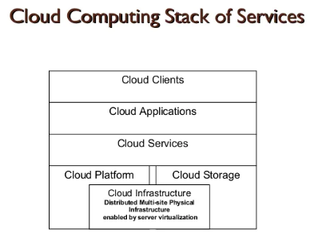
Cloud Computing Architecture
Cloud computing stack

Slide 35
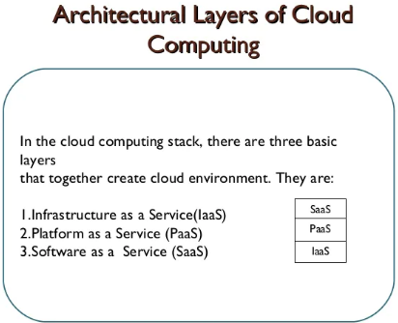

Slide 36
Services provided at various levels
Infrastructure as a Service (IaaS)
Hardware resources
Networking Components, Storage Devices
Platform as a Service (IaaS)
OS, Software tools for design and development.
Server Software, DBMS, Network Access
Hosting Solutions, Environment for server-side scripting
Software as a Service (SaaS)
Software, Editors, software applications

Slide 37
Listing the characteristics of IaaS
Renting
Self-service provisioning
Dynamic scaling
Service levels
Licensing - Bring Your Own License (BYOL) plan

Slide 38
Understanding the benefits of PaaS
✓ Improving the development life cycle
✓ Eliminating the installation and operational burden from an organization
✓ Implementing standardization
✓ Having ease of service provisioning

Slide 39
Advantages of SaaS
Accessibility
Operational Management
Quick set up and deployment
Scalability
Data Storage
Increase Security

Slide 40
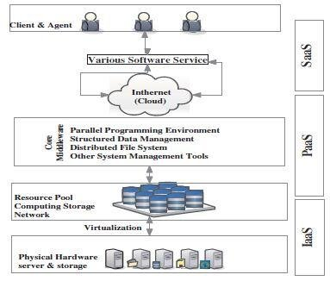
The Framework of Cloud Computing

Slide 41
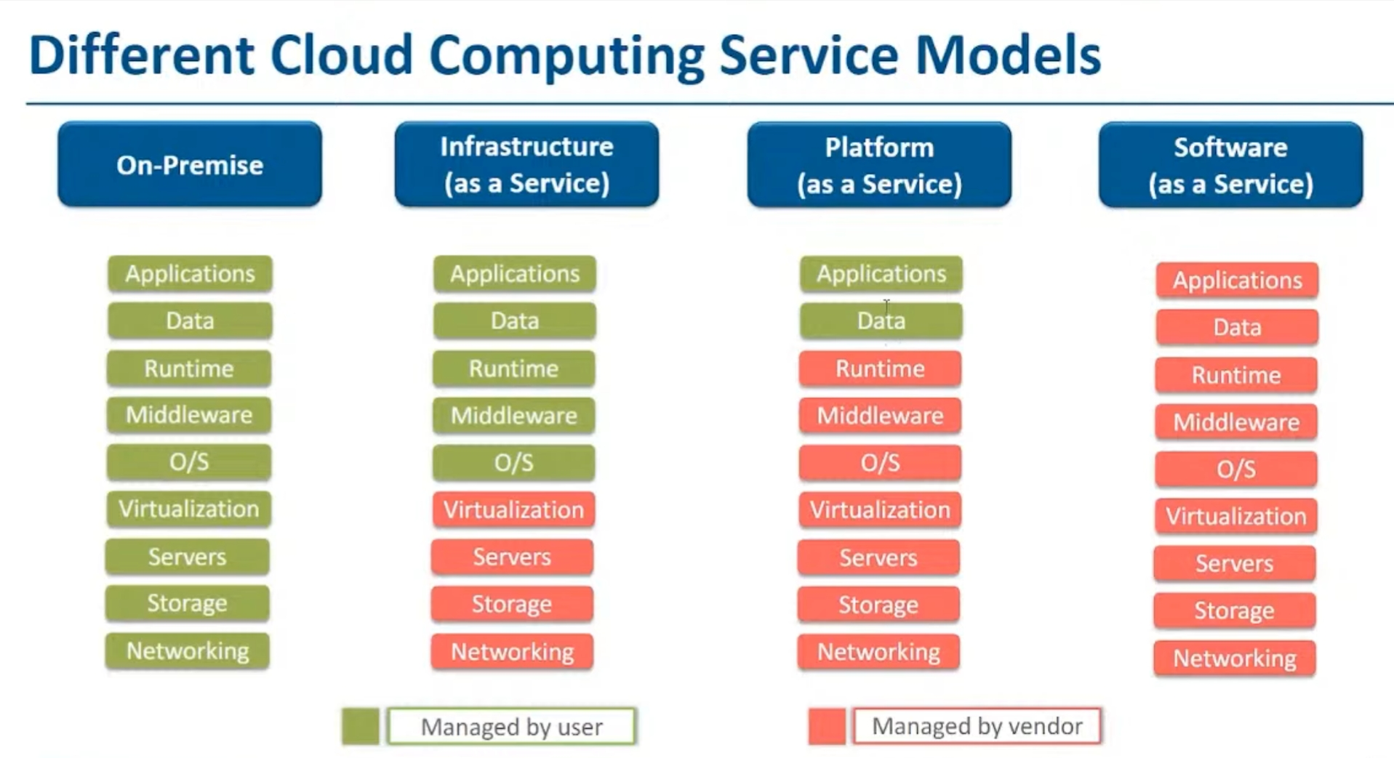

Slide 42
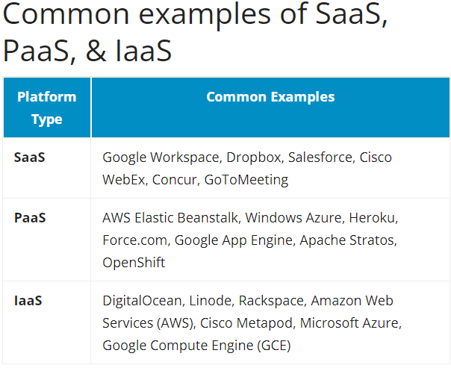

Slide 43
Role of Networks in Cloud computing
Protocols used in Cloud
Gossip Protocol
State Routing Protocol (SRP)
Internet Control Message Protocol (ICMP)
Transmission Control Protocol (TCP)
Secure Shell protocol (SSHP)
Connection-less n/w protocol (CLNP)
Internet Group Management Protocol (IGMP)
Media Transfer Protocol (MTP)
Advanced Message Queuing Protocol (AMQP)
Coverage Enhanced Ethernet Protocol (CEE)
UDP, HTTP

Slide 44
Role Of Network in Cloud
High Scalability: It requests the supply of resources on a huge scale without any human intervention with each service provider.
High availability and Reliability: The servers are available at the right time without any delay or disappointment.
Agility: It shares the resources effectively among the users and works quickly.
Multi-sharing: By distributed computing, different clients from multiple areas share the same resources by fundamental infrastructure.
Maintenance: It is user-friendly as they are easy to access from their place and doesn’t require any installation setup.
Low Cost: It is very cost-effective and pays according to its usage.
Services in pay per use Model: Application Programming Interface is given to customers to use resources and services and pay on a service basis.
On-Demand Self Service: Cloud computing offers the required services and applications to the client. With the login key, they can start to use it without any human interaction and cloud service providers. It includes storage and virtual machines.

Slide 45
Role Of Web Services
Web services are any software, applications, or cloud technologies that connect, interact, and exchange data electronic messages using a standardized Web protocol (HTTP or HTTPS).
By transferring data over a web service, programs written in many languages develop a connection between a client and a server.
A web service is accessed by a client who submits an XML request, and the service returns an XML response.

Slide 46
Components of Web Services
1. SOAP
The acronym SOAP stands for Simple Object Access Protocol.
A convention based on XML for accessing web services.
W3C recommendation for application-to-application communication.
Independent of both platforms and languages
2. UDDI
Universal Description, Discovery, and Integration is referred to as UDDI.
System based on XML.
Information on web administrations

Slide 47
3. WSDL
The acronym for WSDL is Web Services Description Language.
It is an XML file.
It contains information about web administrations, such as the name of the technology, the strategy parameter, and directions to the site.
It serves as a connection point for web administration software.

Slide 48
What is a Cloud Deployment Model?
The cloud deployment model identifies the specific type of cloud environment based on ownership, scale, and access, as well as the cloud’s nature and purpose. The location of the servers you’re utilizing and who controls them are defined by a cloud deployment model.
Cloud Deployment Model functions as a virtual computing environment with a deployment architecture that varies depending on the amount of data you want to store and who has access to the infrastructure.

Slide 49
Public
The public cloud makes it possible for anybody to access systems and services.
The infrastructure in this cloud model is owned by the entity that delivers the cloud services, not by the consumer. It is a type of cloud hosting that allows customers and users to easily access systems and services.
For example, Google App Engine etc.

Slide 50
Advantages of the Public Cloud Model
Minimal Investment: Because it is a pay-per-use service, there is no substantial upfront fee, making it excellent for enterprises that require immediate access to resources.
No setup cost: The entire infrastructure is fully subsidized by the cloud service providers, thus there is no need to set up any hardware.
Infrastructure Management is not required: Using the public cloud does not necessitate infrastructure management.
No maintenance: The maintenance work is done by the service provider (not users).
Dynamic Scalability: To fulfill your company’s needs, on-demand resources are accessible.
Disadvantages of the Public Cloud Model
Less secure: Public cloud is less secure as resources are public so there is no guarantee of high-level security.
Low customization: It is accessed by many public so it can’t be customized according to personal requirements.

Slide 51
Private
It’s a one-on-one environment for a single user (customer). There is no need to share your hardware with anyone else.
The cloud platform is implemented in a cloud-based secure environment that is protected by powerful firewalls and under the supervision of an organization’s IT department. The private cloud gives greater flexibility of control over cloud resources.

Slide 52
Advantages of the Private Cloud Model
Better Control: You are the sole owner of the property. You gain complete command over service integration, IT operations, policies, and user behavior.
Data Security and Privacy: It’s suitable for storing corporate information to which only authorized staff have access. By segmenting resources within the same infrastructure, improved access and security can be achieved.
Supports Legacy Systems: This approach is designed to work with legacy systems that are unable to access the public cloud.
Customization: Unlike a public cloud deployment, a private cloud allows a company to tailor its solution to meet its specific needs.
Disadvantages of the Private Cloud Model
Less scalable: Private clouds are scaled within a certain range as there is less number of clients.
Costly: Private clouds are more costly as they provide personalized facilities.

Slide 53
Public Vs Community
Feature | Public Cloud | Community Cloud
User | Anyone who sign in can use a public cloud | Users with a particular industry segment or group can use it. Users from organizations with common objectives ,specific security policies & compliance factors ,opt for community cloud services
Payment | It uses a pay –per use model which is usually less expensive | It is more expensive and the site is customized for use by an industry group or community
Security | It is less secure | Security is tighter as only few users can have accounts and users are screened
Compliance | Compliance to regulations is not targeted for an industry | Compliance is targeted to an industry vertical
Provider Presence | The provider is usually away from the consumer and often in a different country | The provider is usually known to the consumer

Slide 54
Private Vs Hybrid
Feature | Private Cloud | Hybrid Cloud
Ownership | It is entirely procured ,setup, and managed by the organization | It uses the resources of a public provider on pay per use model
Constraints During Peak Period | Its Performance is constrained | It is more scalable and elastic ,because it can use public resources to meet load spikes
Service Deployment | It is less flexible | It is more flexible and can develop and test services on public demand and later deploy them on a private cloud
Capital Expense | It is as expensive as an internal IT infrastructure | It is less expensive

Slide 55
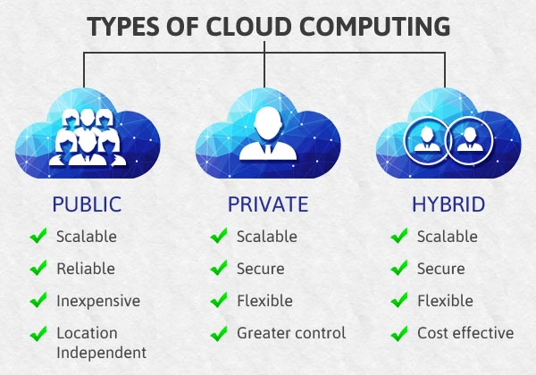

Slide 56
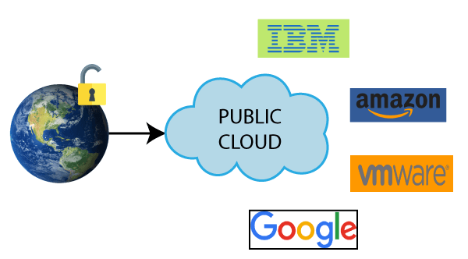
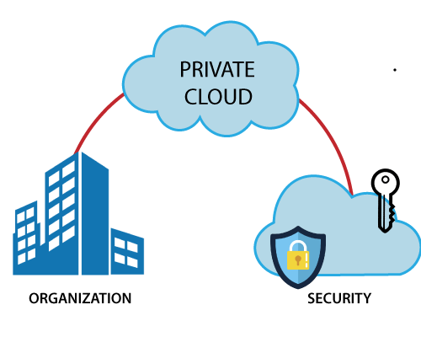
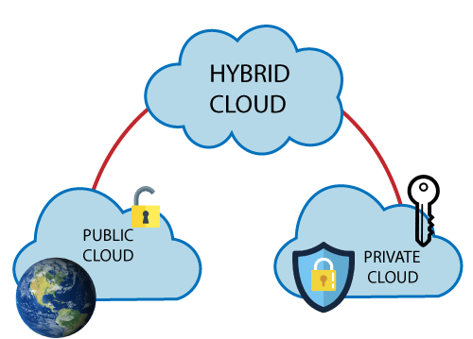
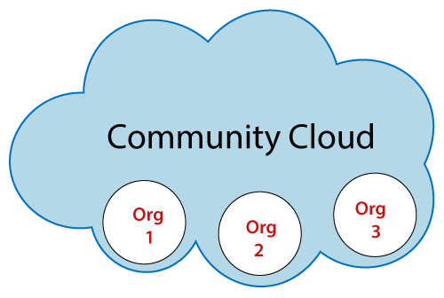

Slide 57
Unit III - Virtualization
Introduction and benefits, Implementation Levels of Virtualization, Virtualization at the OS Level, Virtualization Structure, Virtualization Mechanism, Open-Source Virtualization Technology, XenVirtualization Architecture, Binary Translation with Full Virtualization, Paravirtualization, Virtualization of CPU, Memory and I/O Devices

Slide 58
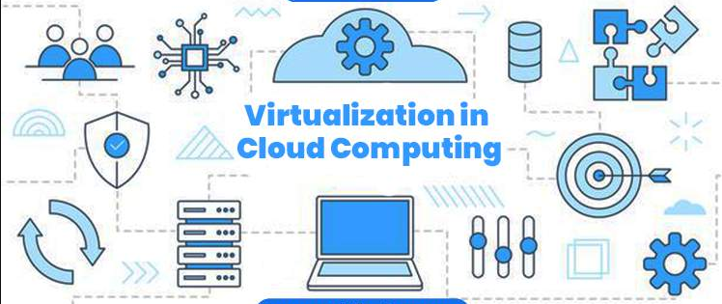
Virtualization in Cloud Computing

Slide 59
Benefits of Virtualization
Resource efficiency
High availability
Easier management
Minimal downtime
Security
Flexible Operations
Increase efficiency and productivity

Slide 60
Types of Virtualization
Hardware Virtualization.
Operating system Virtualization.
Server Virtualization.
Storage Virtualization.

Slide 61
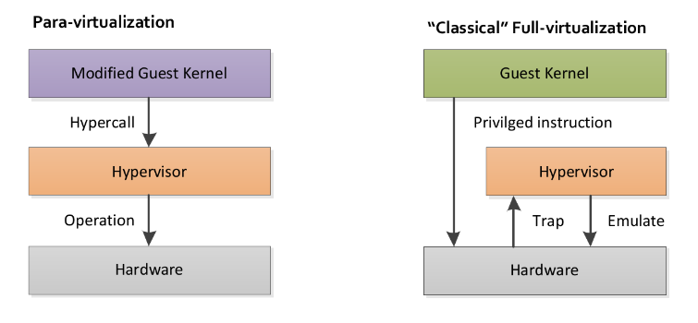

Slide 62
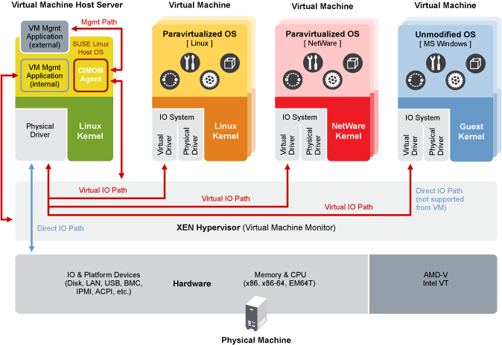
Xen Virtualization Architecture

Slide 63
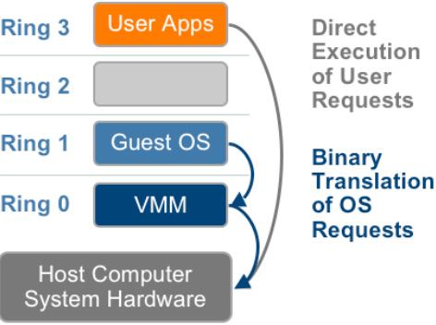
Binary translation with full virtualization

Slide 64
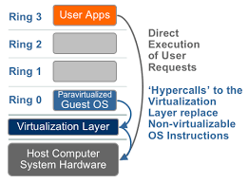
Paravirtualization with compiler support

Slide 65
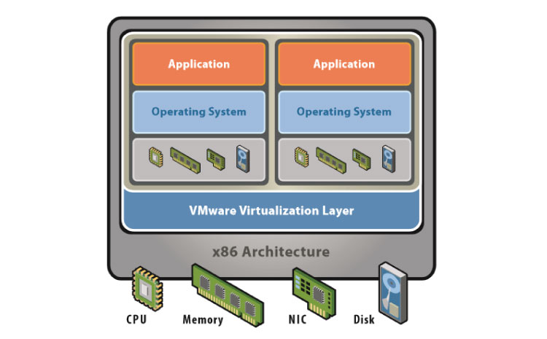
virtualization of the CPU, Memory, IO Devices

Slide 66
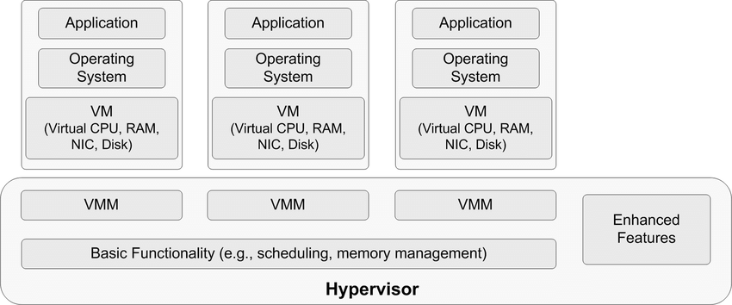
Hypervisor virtualization structure

Slide 67
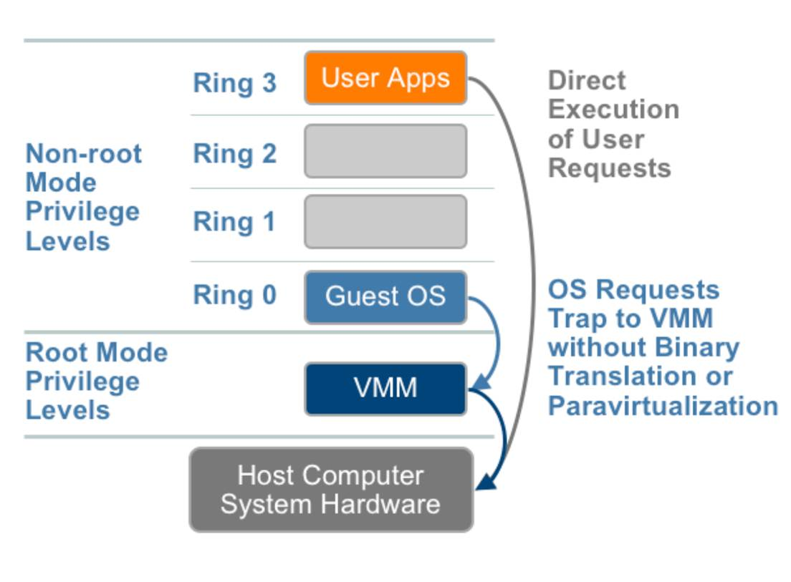
CPU Virtualization with Hardware Assist

Slide 68
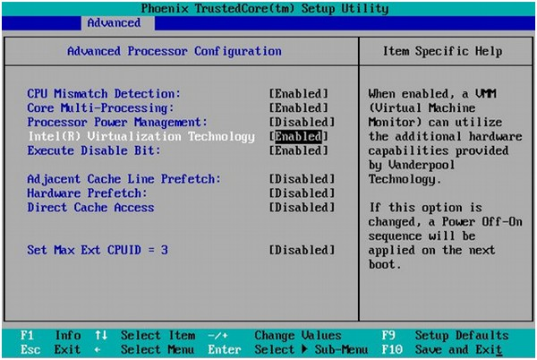

Slide 69
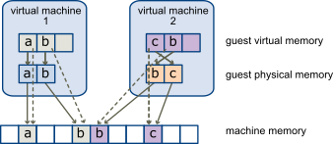
Memory Virtualization

Slide 70
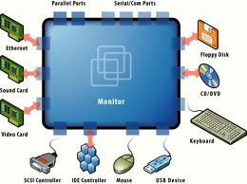
Device and IO virtualization

Slide 71
Unit - 4
Infrastructure as a Service (IaaS): Introduction to IaaS - IaaS definition, Introduction to virtualization, Different approaches to virtualization, Hypervisors, Machine Image, Virtual Machine (VM). Resource Virtualization - Server, Storage, Network. Virtual Machine(resource) provisioning and manageability, storage as a service, Data storage in cloud computing (storage as a service). Renting, EC2 Compute Unit, Platform and Storage, pricing, customers.
Platform as a Service (PaaS): Introduction to PaaS - What is PaaS, Service Oriented Architecture (SOA). Cloud Platform and Management - computation, storage
Software as a Service (SaaS): Introduction to SaaS, Web services, Web 2.0, Web OS, Case Study on SaaS

Slide 72

Infrastructure as a Service | IaaS
IaaS provider provides the following services
Compute Storage Network Load balancers

Slide 73
Advantages of IaaS
Shared infrastructure
Web access to the resources
Pay-as-per-use model
Focus on the core business
On-demand scalability

Slide 74


Slide 75
Introduction to virtualization
Different approaches to virtualization
Para Virtualization
Full Virtualization
Hardware-Assisted Virtualization
Kernel level Virtualization

Slide 76
Hypervisors
A hypervisor is a form of virtualization software used in Cloud hosting to divide and allocate the resources on various pieces of hardware.
Types of Hypervisor –
TYPE-1 Hypervisor TYPE-2 Hypervisor
Choosing the right hypervisor
Hypervisor Reference Model
Dispatcher, Allocator, Interpreter

Slide 77
OpenStack using DevStack
Add Stack User
sudo useradd -s /bin/bash -d /opt/stack -m stack
echo "stack ALL=(ALL) NOPASSWD: ALL" | sudo tee /etc/sudoers.d/stack
sudo -u stack –I
Download DevStack
git clone https://opendev.org/openstack/devstack
cd devstack
Create a local.conf
Start the install
./stack.sh

Slide 78


Slide 79
Machine Image
Use a machine image to store all the configuration, metadata, permissions, and data from one or more disks for a VM instance running on Compute Engine
A virtual machine image is a template for creating new instances.

Slide 80


Slide 81
Virtual machine
A VM is a virtualized instance of a computer that can perform almost all of the same functions as a computer, including running applications and operating systems.
Consolidate servers
Create development and test environments
Support development
Enable workload migration
Improve disaster recovery and business continuity
Create a hybrid environment

Slide 82


Slide 83
Resource Virtualization
Server Virtualization is the partitioning of a physical server into a number of small virtual servers, each running its own operating system.
Types of Server virtualization
Hypervisor

Slide 84

Para Virtualization
Advantages:
Easier
Enhanced Performance
No emulation overhead
Limitations:
Requires modification to a guest operating system

Slide 85

Full Virtualization
Advantages:
No modification to the Guest operating system is required.
Limitations:
Complex
Slower due to emulation
Installation of the new device driver is difficult.

Slide 86
Hardware-Assisted Virtualization
Advantages:
No modification to a guest operating system is required.
Very less hypervisor overhead
Limitations:
Hardware support Required
Example - AMD – V Pacifica and Intel VT

Slide 87

Kernel level Virtualization
Advantages:
No special administrative software is required.
Very less overhead
Limitations:
Hardware Support Required

Slide 88
Storage Virtualization
Sharing of physical storage into multiple storage devices
Improve the management of the storage.
Storage availability is better
Storage virtualization will provide better storage utilization
Methods of Storage Virtualization
File-based Storage Virtualization
Block-based Virtual Storage

Slide 89
Types of Storage Virtualization
Hardware Assisted Virtualization
Kernel Level Virtualization
Hypervisor Virtualization
Para-Virtualization
Full Virtualization
How Storage Virtualization Apply? Host-Based
Network-Based
Array-Based

Slide 90


Slide 91
Network virtualization
Network Virtualization is a process of logically grouping physical networks and making them operate as single or multiple independent networks called Virtual Networks.
Tools for Network Virtualization
Physical switch OS
Hypervisor
Functions of Network Virtualization :
It enables the functional grouping of nodes in a virtual network.
It enables the virtual network to share network resources.
It allows communication between nodes in a virtual network without routing of frames.
It restricts management traffic.
It enforces routing for communication between virtual networks.

Slide 92

Enhances security
Improves manageability
Advantages of Network Virtualization
Improves utilization
Enhances performance

Slide 93

Platform as a Service (PaaS)

Slide 94
Platform as a Service (PaaS)
Like IaaS, PaaS includes infrastructure—servers, storage and networking—but also middleware, development tools, business intelligence (BI) services, database management systems
PaaS is designed to support the complete web application lifecycle: building, testing, deploying, managing and updating
PaaS allows you to avoid the expense and complexity of buying and managing software licenses, application infrastructure and middleware, development tools and other resource

Slide 95

Example - Google App Engine (GAE)
Salesforce.com, AWS Elastic Beanstalk, OpenShift

Slide 96
Deploy to AWS using Elastic Beanstalk you need to perform the following steps:
Create an Elastic Beanstalk application.
Create an environment where you wish to deploy your application.
Create a S3 bucket where you can store your application to be deployed.
Create an application version to deploy.

Slide 97
Advantages of PaaS
Cut coding time
Add development capabilities without adding staff.
Develop for multiple platforms - including mobile - more easily
Use sophisticated tools affordably
Support geographically distributed development teams
Efficiently manage the application lifecycle

Slide 98

Service-Oriented Architecture (SOA)
A service-oriented architecture is essentially a collection of services. These services communicate with each other.

Slide 99


Slide 100
Software as a Service - SaaS

Slide 101

Software as a Service - SaaS

Slide 102
Services provided by SaaS providers
Business Services – ERP, CRM, billing & sales
Document Management - create, manage, and track electronic documents.
Social Networks- Handle the general public's information.
Mail Services - load on e-mail services

Slide 103
Advantages of SaaS
SaaS is easy to buy
One to Many
Less hardware required for SaaS
Low maintenance required for SaaS
No special software or hardware versions required
Multidevice support
API Integration
No client-side installation

Slide 104


Slide 105
Web Sevices
Web services are self-contained, modular, distributed, dynamic applications that can be described, published, located, or invoked over the network to create products, processes, and supply chains.
Web services are XML-based information exchange systems that use the Internet for direct application-to-application interaction.
A web service is a collection of open protocols and standards used for exchanging data between applications or systems.

Slide 106
Web services
XML to tag the data
SOAP (Simple Object Access Protocol) to transfer a message
WSDL (Web Services Description Language)to describe the availability of service.

Slide 107


Slide 108

Types of Web Services
SOAP web services.
RESTful web services.

Slide 109


Slide 110

Web 2.0

Slide 111
Benefits of Web 2.0
We can access all the services available at internet anytime or from anywhere.
Today’s web services are user friendly or has better user interface.
Multiple kind or different type of media is available on web.
It can build a dynamic learning communities.
Everybody is an author and an editor now, every thing or every changes are traceable now.
Learners can actively be involved in knowledge building.
Updates of any information is easy.
Web 2.0 is speedy, collaborative, etc.

Slide 112
Service running on web 2.0
Facebook
Flicker
Linked in
YouTube
Wikipedia
BlogSpot
Word press
Twitter
Pinterest
Google Docs
Instagram and many more.

Slide 113

Web OS
Linux kernel-based multitasking operating system for smart devices.

Slide 114
Service-level agreement
A cloud SLA (cloud service-level agreement) is an agreement between a cloud service provider and a customer that ensures a minimum level of service is maintained.
The agreement should outline characteristics like availability, accuracy, response time, throughput, and security
Customer-based SLA
Service-based SLA
Multilevel SLA (Corporate, Customer, Service)

Slide 115


Slide 116
Tracking Service Level Agreements
Response times (possibly varying by transaction)
Availability on any given day
Overall uptime target
Agreed-on response times and procedures in the event a service goes down
Types of SLA Penalties
Financial penalty, Service credit

Slide 117
Billing & Accounting
Pay-as-you-go models
Licensing model
Subscription models
Free models

Slide 118
Comparing Scaling Hardware: Traditional vs. Cloud
Servers.
Storage and Databases.
Networking and Routing
Maintenance, Security, and Disaster Recovery
Vertical scaling
Horizontal scaling

Slide 119


